Slide 1
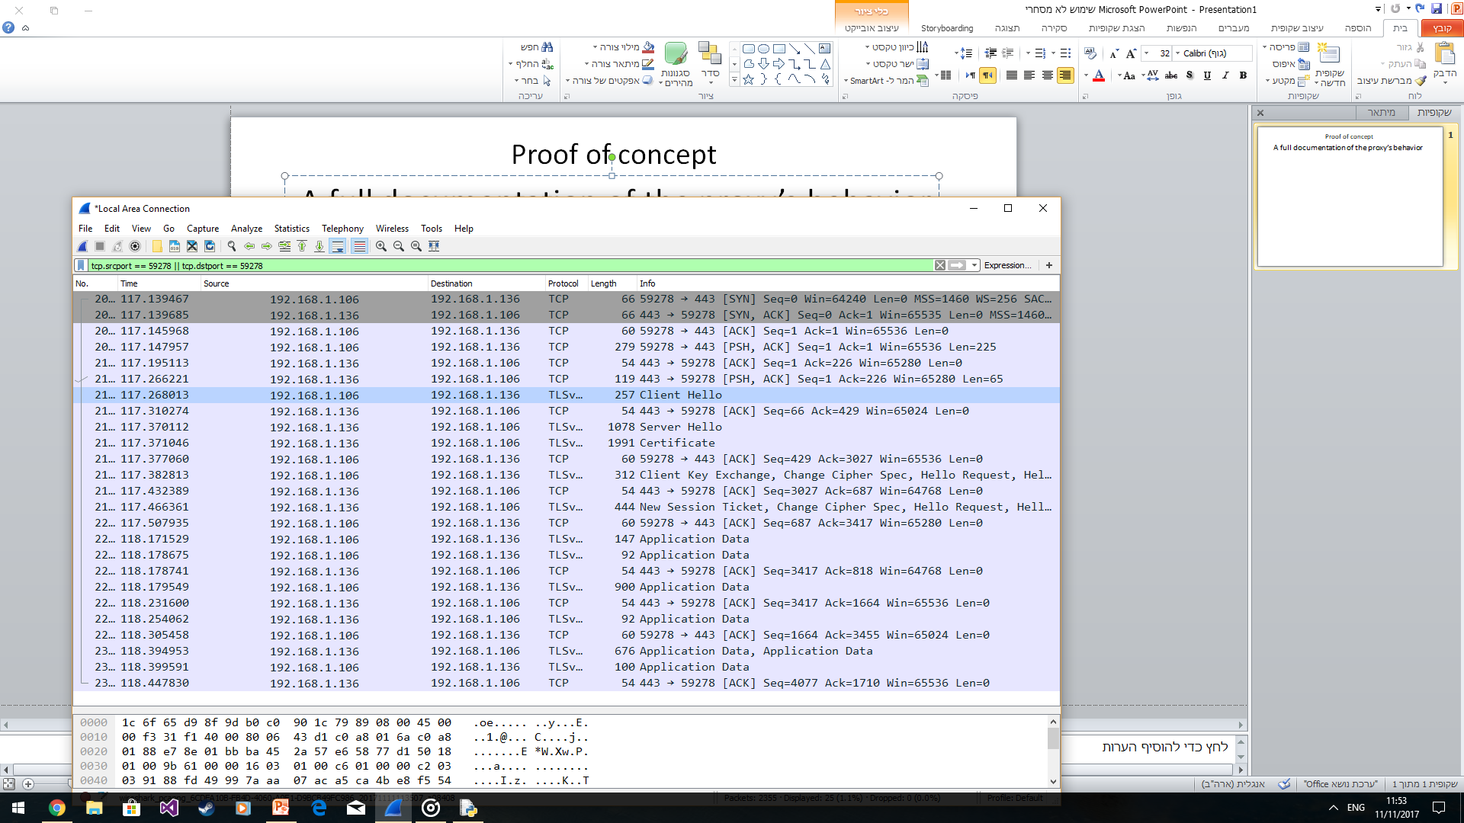
Proof of Concept
Ido Rozval
A full documentation of the proxy’s behavior

Slide 2
HTTPS tunneling – the standard structure
syn
syn-ack
ack
tcp
http CONNECT
syn
syn-ack
ack
http CONNECTION ESTABLISHED
CLIENT HELLO
CLIENT HELLO
SERVER HELLO
SERVER HELLO
SERVER CERT
SERVER CERT
tunneling
CLIENT KEY EXCHANGE
CLIENT KEY EXCHANGE
Aplication Data
Aplication Data
Client 192.168.1.106/59278
Proxy 192.168.1.136/443
Google/443

Slide 3
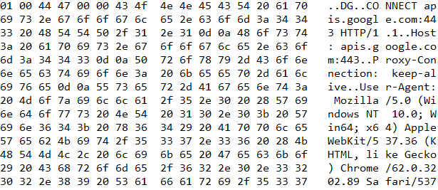
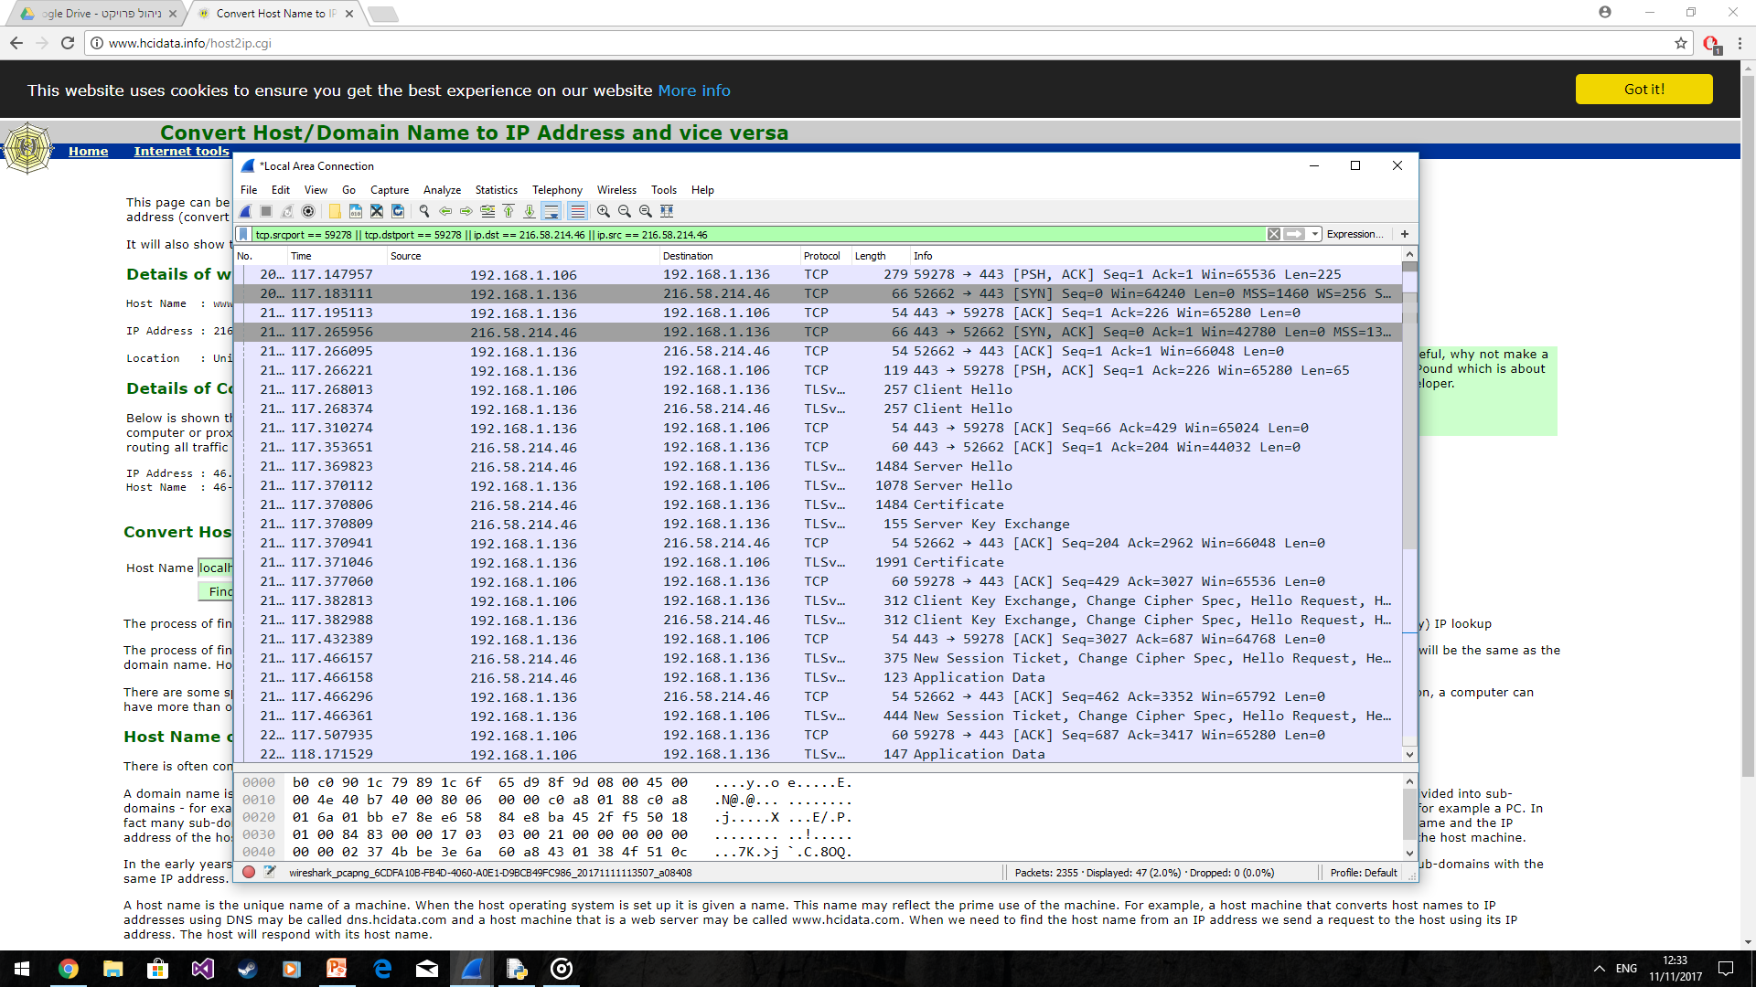
Tcp handshake client -> proxy
CONNECT apis.google.com:443 HTTP/1.1
Tcp handshake proxy -> Google

Slide 4
Tunneling establishment

Slide 5
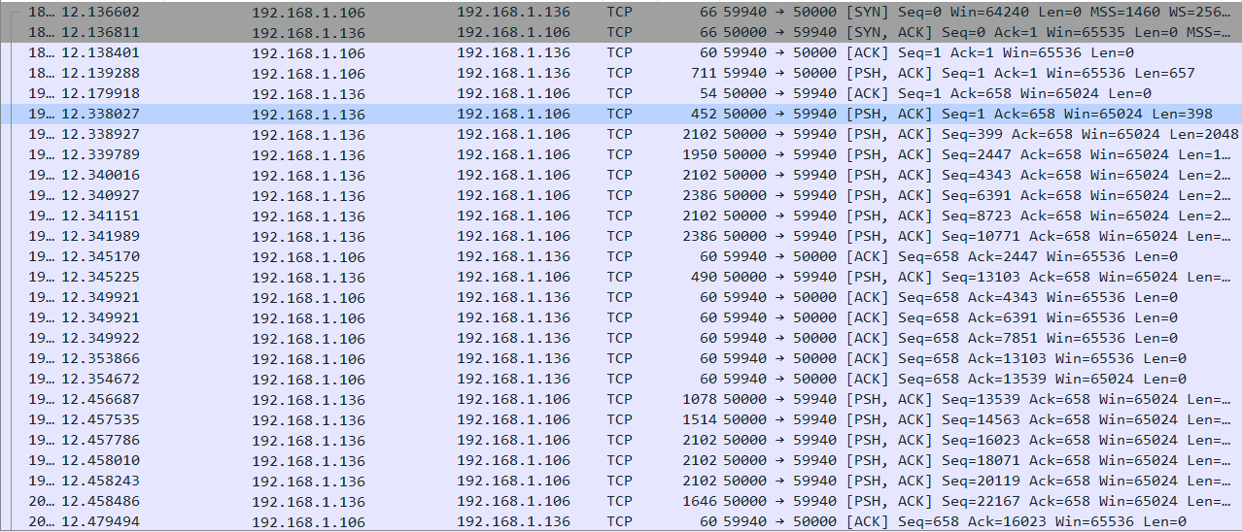
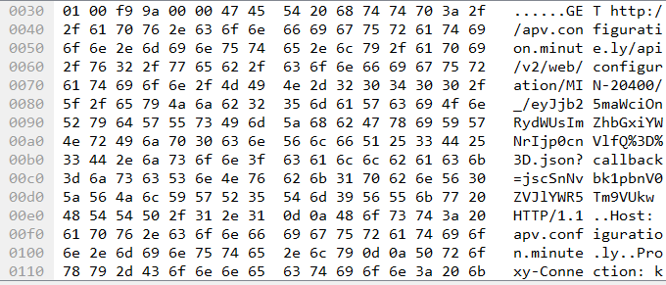
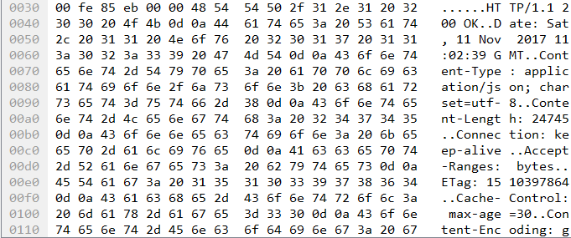
HTTP request – Ynet dump
Get request
200 Ok respond

